Slide 1
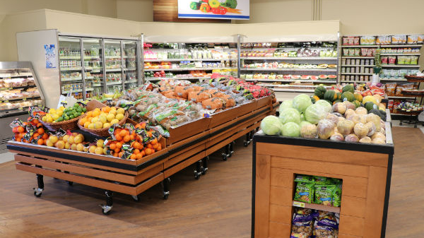
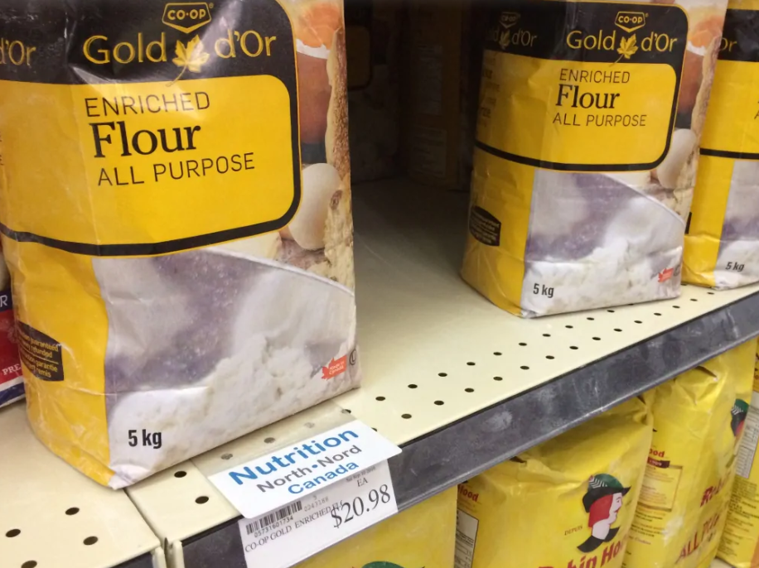
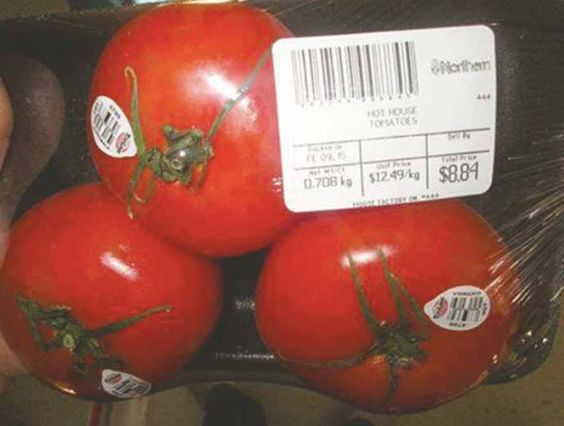
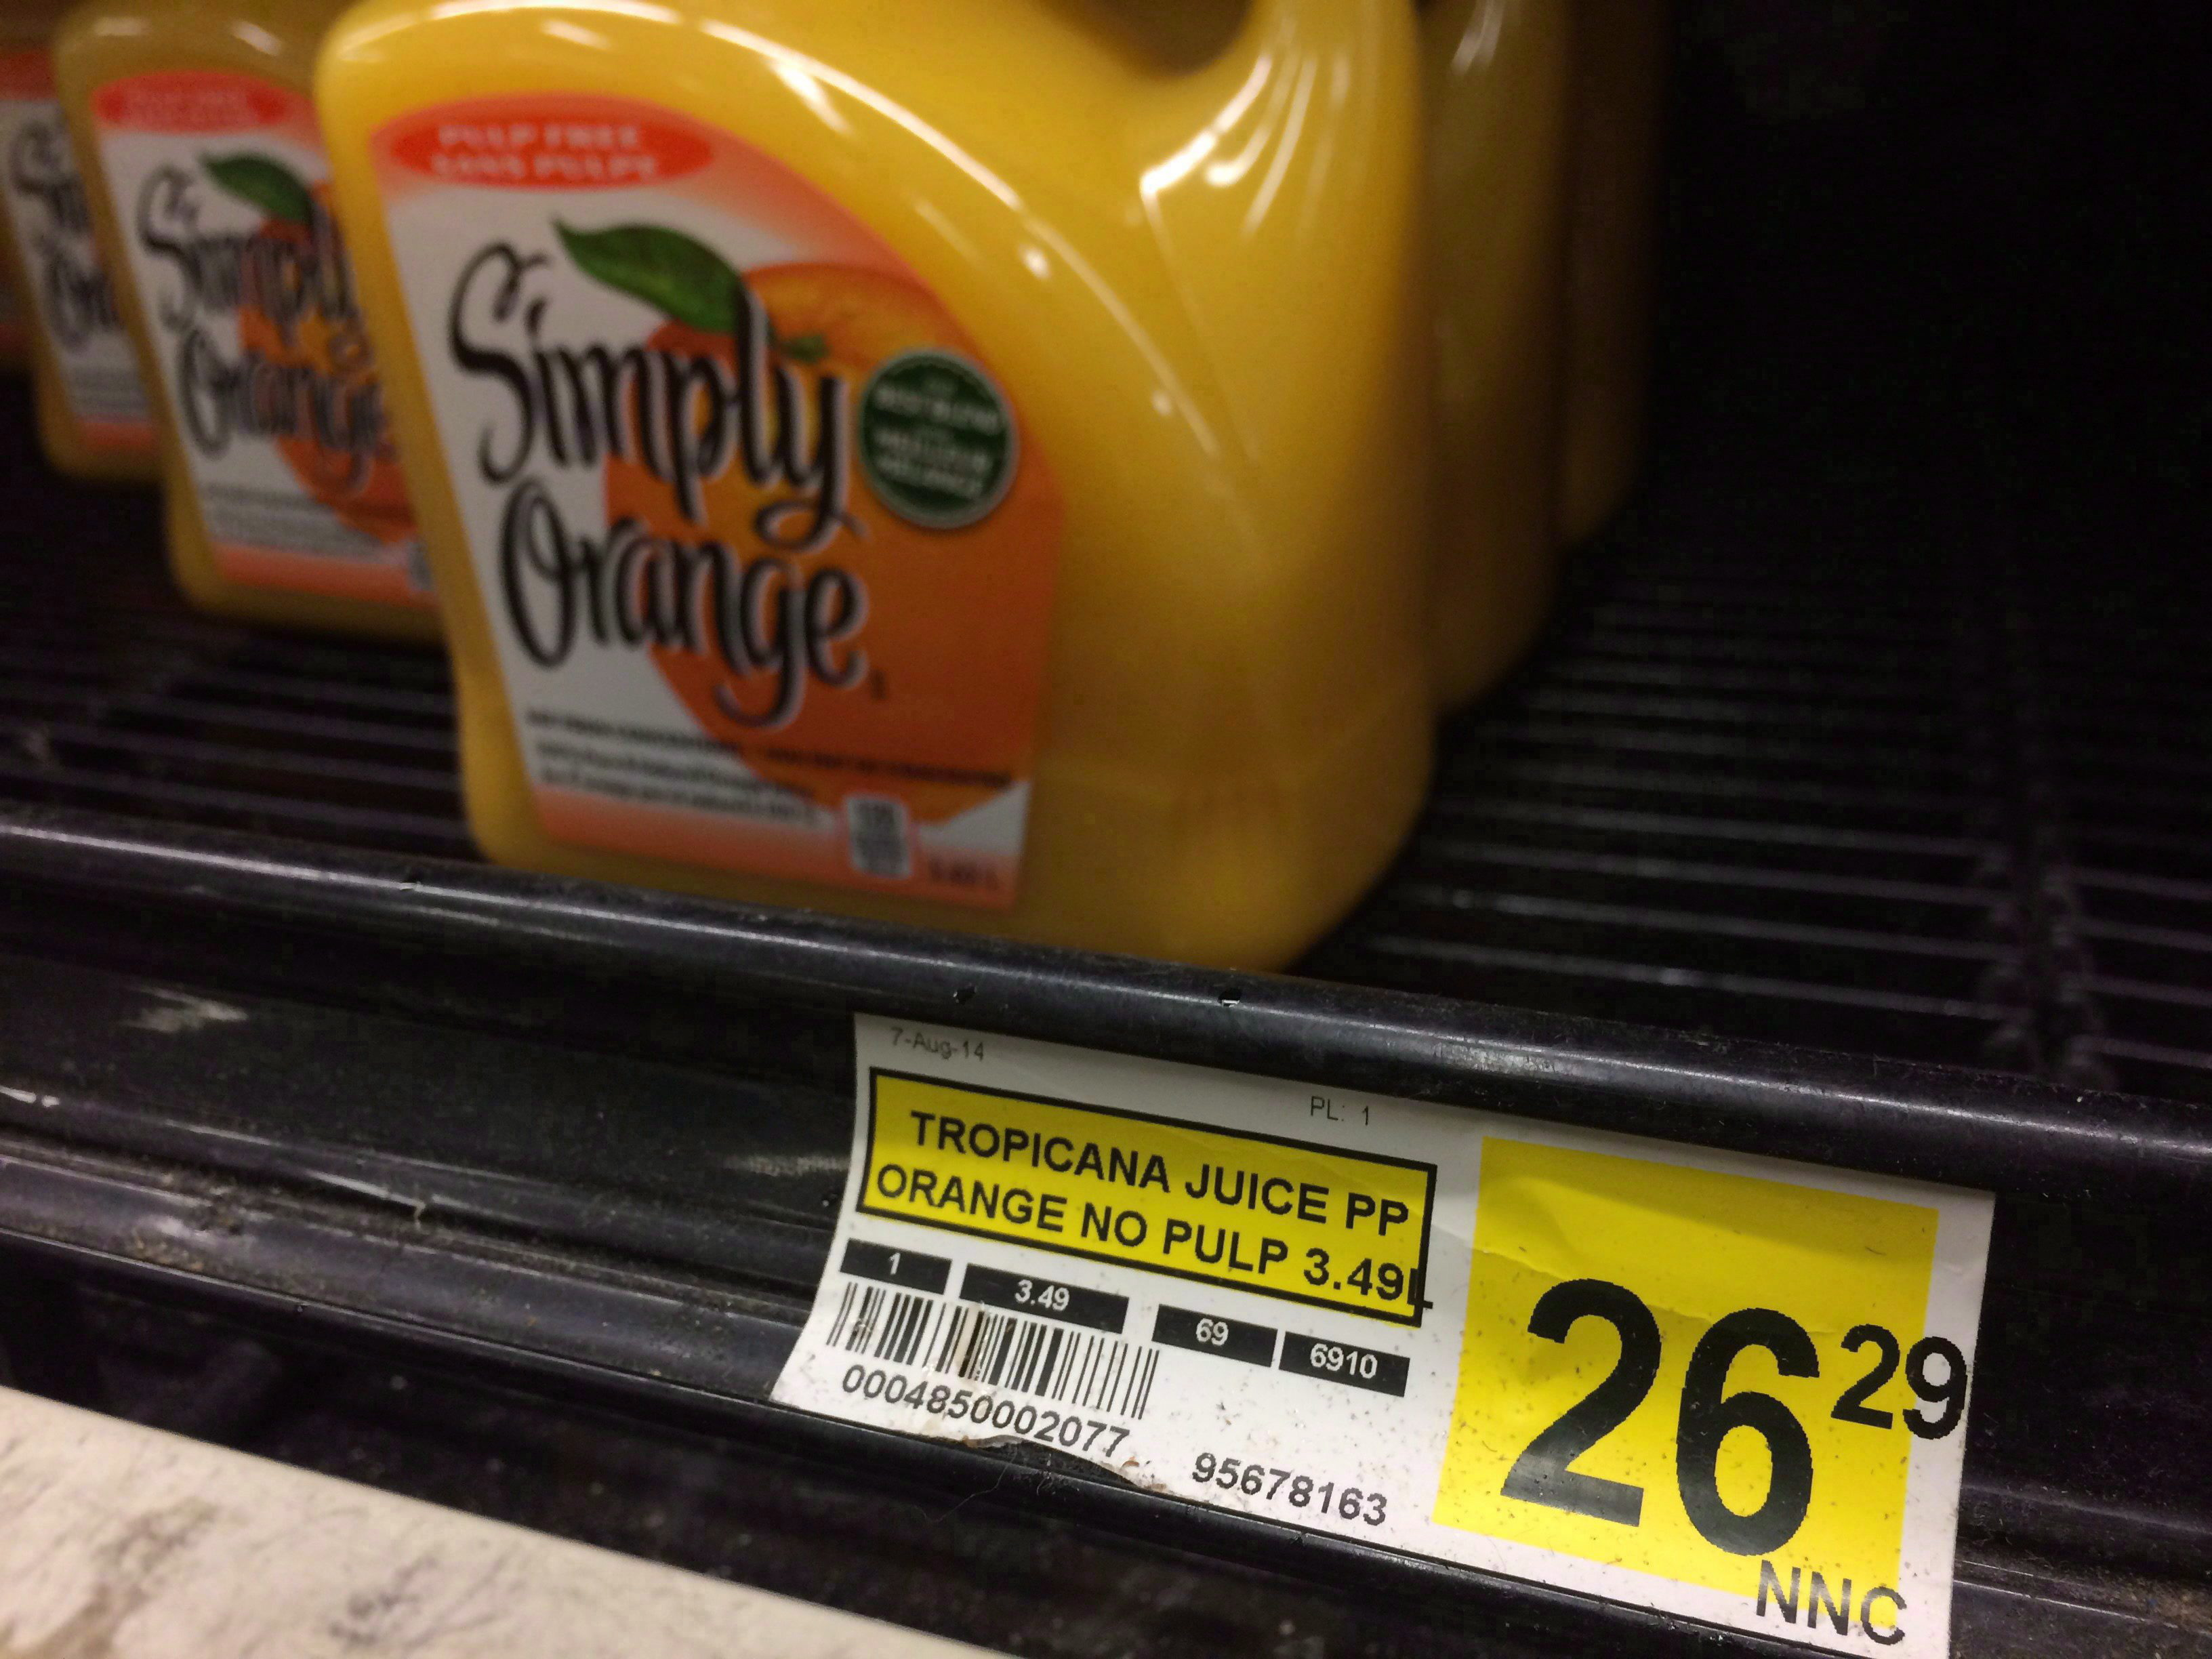
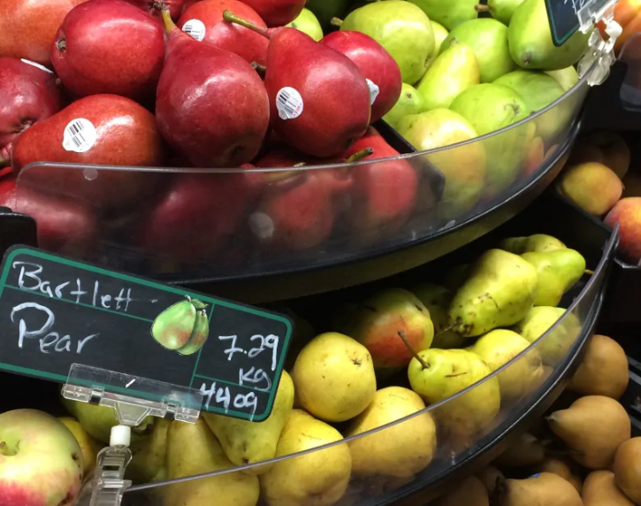
Northmart, Iqaluit
Team 23

Slide 3

Cost of a week’s groceries for a family of 4
in Ontario: ~$125
In Nunavut? ~$500.
https://www.cbc.ca/news/canada/north/20-flour-to-13-juice-a-look-at-the-high-cost-of-food-in-iqaluit-1.3782084
https://www.chatelaine.com/living/when-500-isnt-enough-to-buy-groceries-for-a-week/

Slide 4
Food insecurity is a severe issue in Canada
Remote communities are particularly at risk
70%
of all households in Nunavut have trouble accessing enough affordable, nutritious food
90%
of Aboriginal respondents in the Northwest Territories felt they did not have enough money for food

Slide 5
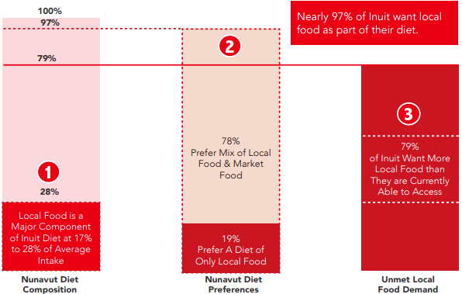
Limited distribution reduces selection of food for locals
97% of Inuit want local food as part of their diet
Weak distribution capabilities
Limited community connectivity
Diminishing food education
Source: Renata Rosol, “Evaluating Food Security in Nunavut: Preliminary Results from the Inuit Health Survey,” Master of Public Health Thesis, Faculty of Health Sciences, Simon Fraser University, 2009.

Slide 6
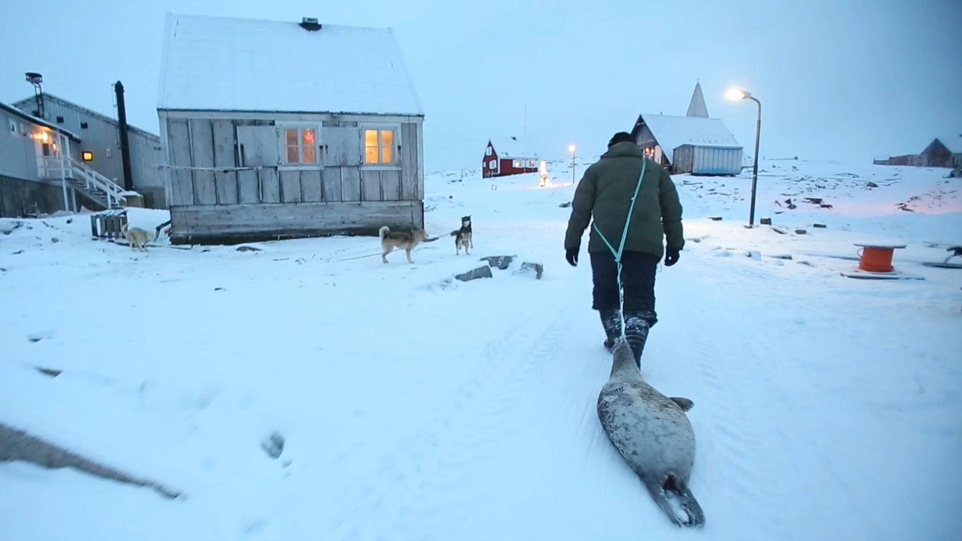
Facilitating more intercommunity trade increases food security and availability by
making the local economy more robust.

Slide 7


A virtual market place tailored for remote communities
Mobile
Online
Our solution minimizes data and internet usage, enabling easy scalability to any remote location

Slide 8
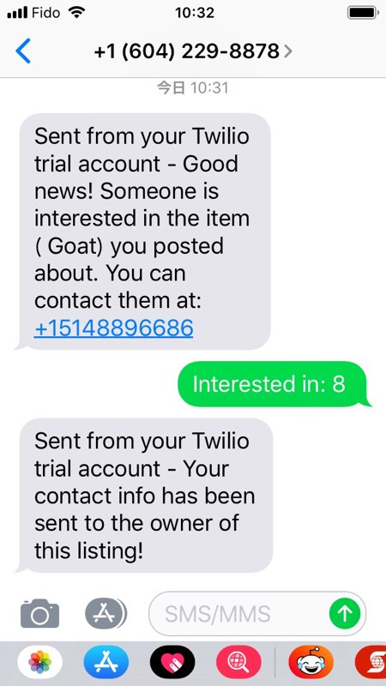



Mobile
Phone
Leverages cellular network for accessibility
Connects nearby individuals to trade
Facilitates market through text messages

Slide 9

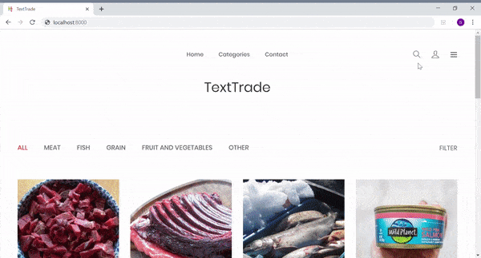

Online
Categorizes available products for trade
Hosts specialty grocery shipping to fulfill orders

Slide 10
Scaling our solution to maximize impact
5 years
5 years
27K
113K
7.88M
Pilot program in Nunavut to test solution in critical environment
Short-term expansion across Canada with existing capabilities
Growing capabilities for a North American-wide rollout

Slide 11
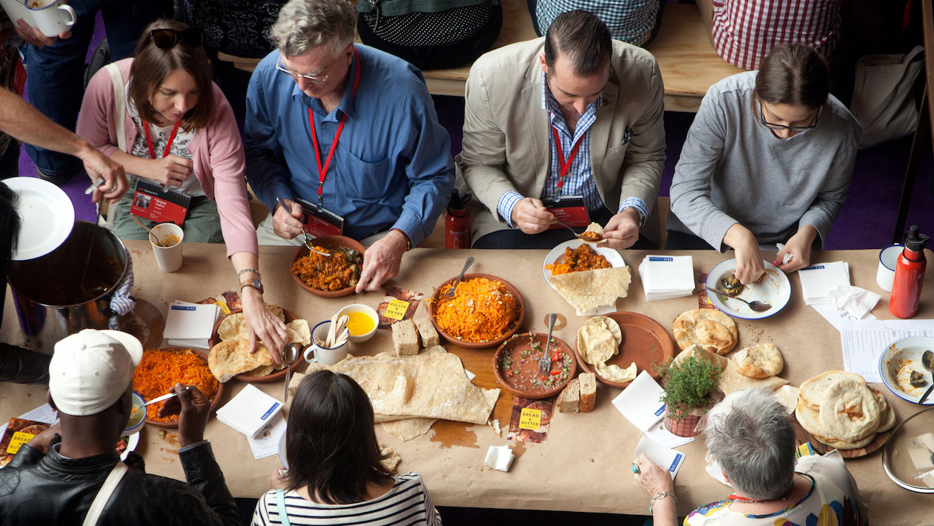
Thank you

Slide 12
Appendix
Overview
Appendix
Food security in Canada
Limited Selection of Food
Virtual Marketplace
Mobile Demo
Online Demo
Scalability and Impact
Financial Impacts
Inputs and Assumptions
5-year projections
Financial Impacts
Risk and Mitigations
Alternative Funding Methods
Implementation Timeline
Data Applications
Data Monetization
Internal Optimization
User Profile
Food Insecurity Background Information
Household food insecurity in Canada
Barriers to Acquiring local food
Nutrition North Canada - Subsidy

Slide 13
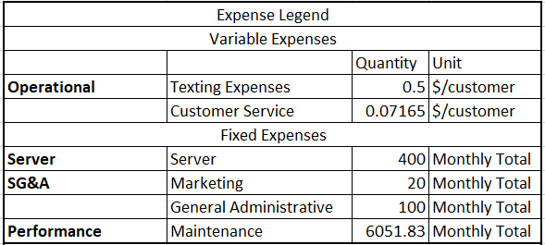
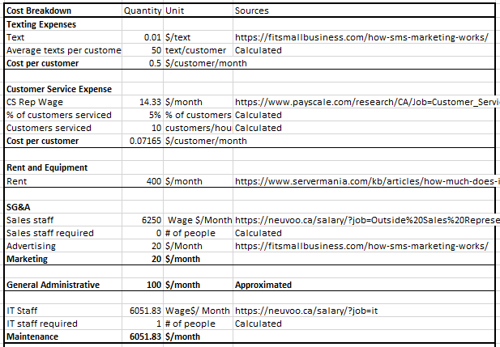
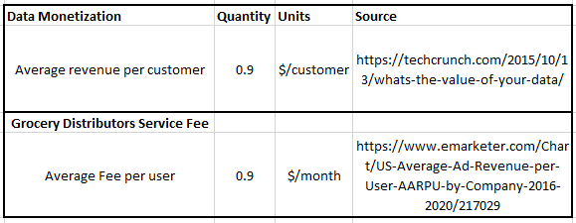
Appendix I: Inputs and Assumptions

Slide 14
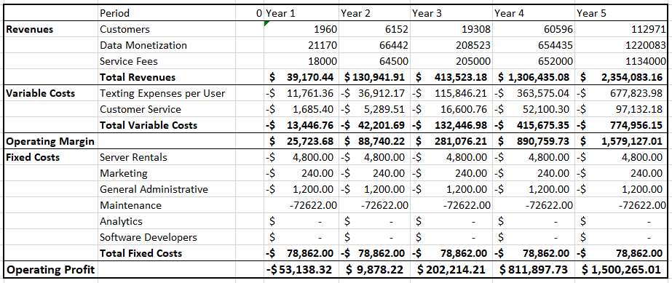
Appendix II: 5 year projections

Slide 15
Appendix III: Financial Impacts
$239.98
5-year NPV
10.02%
IRR

Slide 16
Appendix IV: Risk and Mitigations
Risks
Mitigation
1
Learning Curve
User adoption may be impaired by inability to use the platform
Current UX prompts correct usage; potential plans for better NLP
High
2
3
2
Network adoption often leaves out individuals who are disconnected from the community
“Stragglers” Problem
Employ phone advertising strategies that specifically target users distant from existing network
Medium
1
PROBABILITY
High
Low
3
System Abuse
Users may use the system in unintended ways, potentially trading contraband
Inform local law enforcement of infringements and make clear to users of the public information
Medium
IMPACT
Low

Slide 17
Appendix V: Business Model Alternatives
Category | Advertising Revenue | “Market Place” Model | Data monetization | Premium Grocer Access
Revenue Potential
Competitive Advantage
Operational Feasibility
Brand Integrity
Why Focus on Data Monetization ?
Sufficient revenue stream to sustain costs.
Greatest potential for scalability given unique data set provided
Operational feasibility is high given limited involvement in selling raw data
Can be set up to run mostly passively

Slide 18
Appendix VI: Implementation Timeline
 | 2019 (Startup) |  | 2020 |  | 2021 |  | 2022 |  | 2023
Set-up server and hire IT staff
Seek government and specialty grocers as potential customers
Launch and operate trading platform in Nunavut
Expand operations to other remote communities
Collect and monetize data
Leverage data to improve marketing and operations

Slide 19
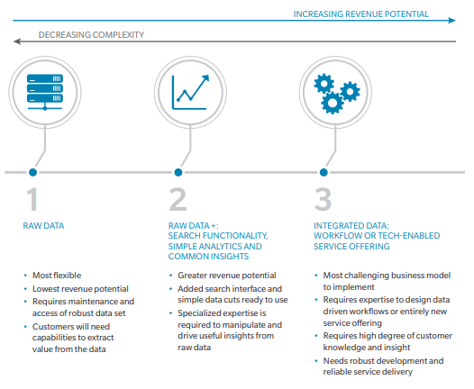
Appendix VII: Data Monetization
Target Customers
Government Organizations
Nutrition North Canada
Health Canada
Indigenous Services Canada
Specialty Grocers and Delivery Services
Northern Shopper
Arctic Fresh
Amazon
Source: https://www.oliverwyman.com/content/dam/oliver-wyman/v2/publications/2016/dec/MONETIZING-DATA.pdf

Slide 20
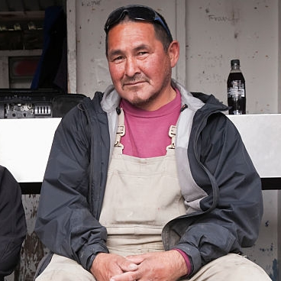



Appendix VIII: User Profile
$20 000 | 45 | Store manager
Monthly Income | Age | Occupation
Major Opportunities and Pain Points
Store has stable wifi network, home is limited
Father of two children; would love to spend as much time with his family as possible
Limited data access through phone, often unreliable
Some hunting knowledge but finds little time to do so
Any food insecurity solution must accommodate for his special circumstances

Slide 21
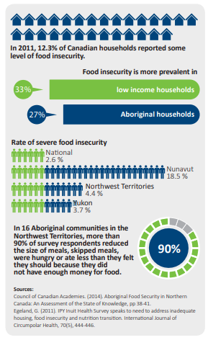
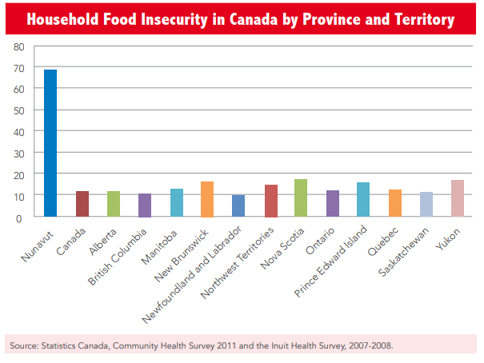
Appendix IX: Household Food Insecurity in Canada
Nunavut and the other territories have the highest rates of food insecurity throughout Canada.

Slide 22
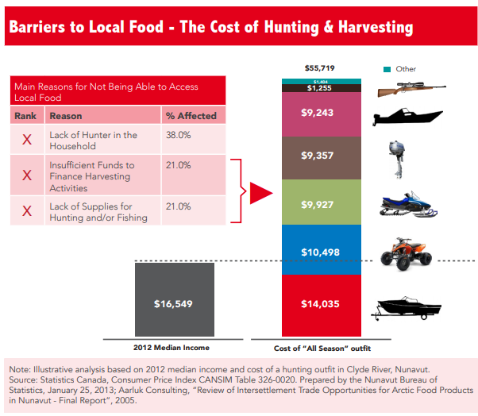
Appendix X: Barriers to Acquiring Local Food
Weak distribution capabilities
Few major distribution centres
Nutrition North Subsidies are often underutilized
Limited community connectivity
Hunters, processors, and local retail outlets are often disconnected
Diminishing food education
Younger generations are less inclined to hunt than parents
Source: http://www.actioncanada.ca/wp-content/uploads/2014/04/TF-3-Hunger-in-Nunavut-EN.pdf

Slide 23
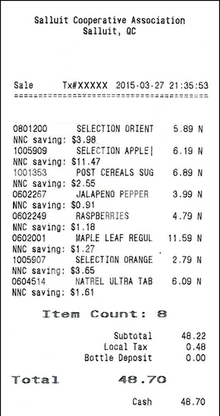
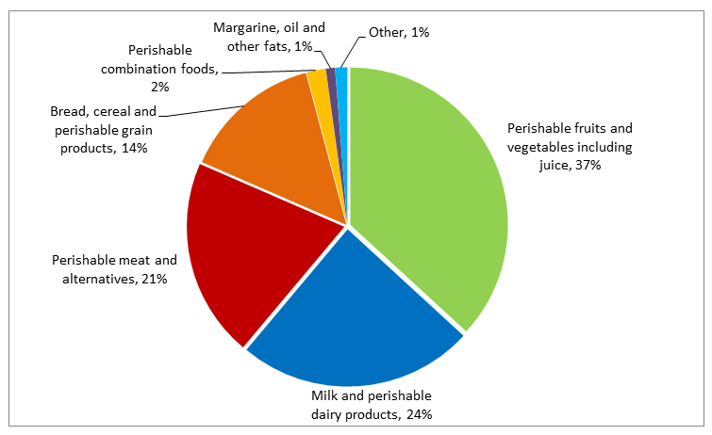
Appendix XI: Nutrition North Canada - Food Subsidy
https://www.nutritionnorthcanada.gc.ca/eng/1415538638170/1415538670874
Subsidies are provided to grocers largely intended for perishable products.

